Slide 1

Sacramento County ECE Cost Modeling
Information Session
August 2026

Slide 2
Agenda
Sacramento County ECE Cost Modeling
What is Cost Modeling and is it important?
Who is needed for a Cost Model?
Cost Modeling Timeline
Survey Information & Resources

Slide 3
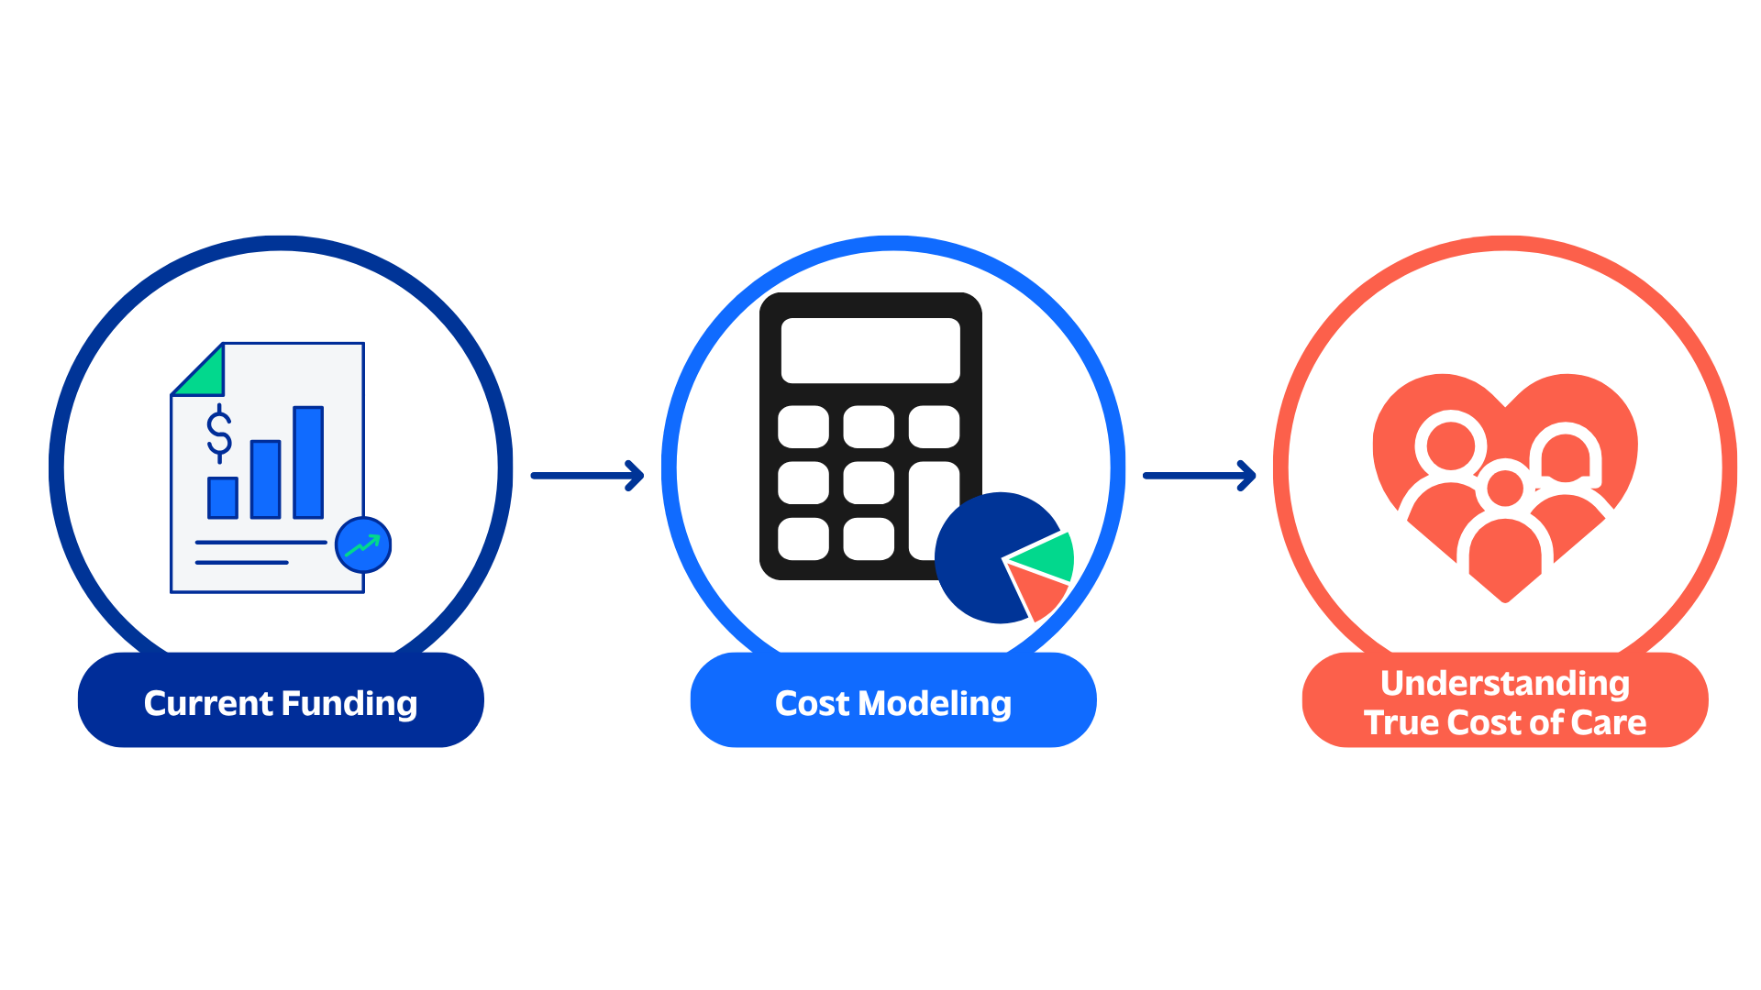
What is Cost Modeling?
Cost modeling estimates the actual cost of providing high-quality child care under defined assumptions.
Adequacy vs Scarcity
It helps answer:
What does quality care cost?
What resources are needed?
Where do funding gaps exist?
Child Action is developing this cost model with guidance and coaching from Children's Funding Project, a national nonprofit social impact organization that helps communities, states, and Native nations expand equitable opportunities for children and youth through strategic public financing.

Slide 4
Why This Matters in Sacramento County
Support a sustainable child care system
Understand workforce and operational realities
Advance equitable access and quality
Build a credible foundation for future funding discussions

Slide 5
What Success Looks Like
A trusted, community-informed understanding of the true cost of care in Sacramento County
Meaningful participation from diverse provider types and communities
Data that reflects both financial realities and provider experiences
A foundation for future policy, funding, and system improvement discussions

Slide 6
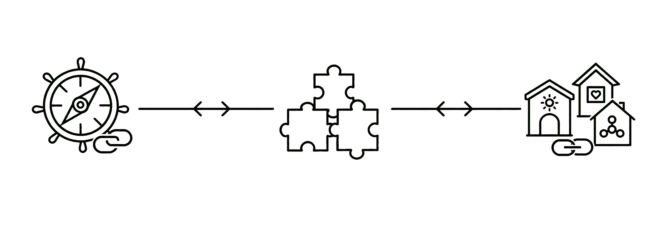
Who is Needed for a Successful Cost Modeling Effort?
An ecosystem of providers and professionals working together on a county-wide goal
Local Lead
Working Group
Providers
Child Action
Community of ECE Professionals
Center, Family-Based, and FFN Providers
Initiates and oversees the cost modeling project
Helps make decisions about scope and direction
Connects local lead with providers and other key groups to ensure quality and accuracy
Participates in surveys and focus groups to provide data on the cost of delivering services, revenue sources, and expenses

Slide 7
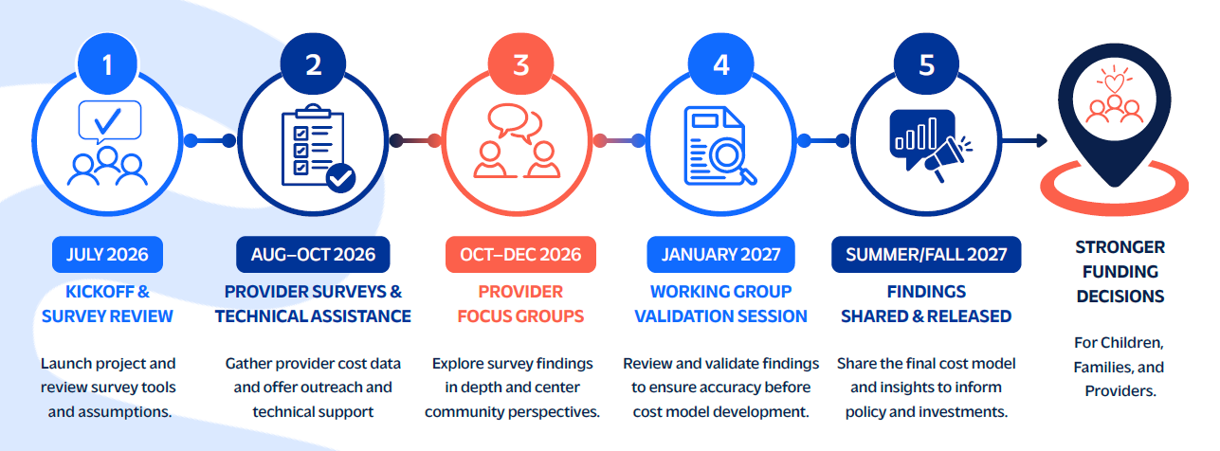
Cost Modeling Timeline
Survey Deadline – October 2, 2026

Slide 8
Example Data Points for Cost Model
Personnel Costs
Staffing patterns
Wages
Benefits
Turnover
Operating Costs
Facilities
Utilities
Insurance
Supplies
Food
Professional development
Revenue Sources
Subsidy payments
Parent fees
Grants
CACFP
Community & Equity Factors
Workforce realities
Special populations served
Regional conditions

Slide 9
Records to Gather
Having your 2025 financial, payroll, enrollment, and operating records available may help you complete the survey.
Child care payment or reimbursement statements
Records of payments received directly from families
Attendance records showing when you provided care
Receipts estimating food, supplies, transportation, and activities
Mileage records and/or estimates
Rent/mortgage and utility statements if care is provided in your home
Federal and state tax returns or other financial statements
Any additional financial records related to your program's revenues and expenses

Slide 10

Confidentiality / Information Privacy
Please note your information will be kept confidential.
Information will not be attributed to individual programs but rather will be combined and reported out as averages, in summary form.
Only those individuals responsible for date entry and analysis will have access to your information.
Your information will be downloaded from QuestionPro and kept secure in a password-protected, data-storage application.

Slide 11
Survey Links & Resources
Survey Links:
Family, Friend, & Neighbor (FFN)
Family Child Care Home (FCCH)
Child Care Center
$25 gift card to first 100 providers to complete the survey!
Distributed within 30 days after the survey closes.
Virtual Office Hours:
Date: Wednesday, August 26
Time: 6:00pm – 7:00pm
Date: Saturday, August 29
Time: 9:00am – 10:00am
Date: Friday, September 4
Time: 1:00pm – 2:00pm
Date: Wednesday, September 16
Time: 6:00pm – 7:00pm
Date: Friday, September 25
Time: 1:00pm – 2:00pm
[Zoom Link]
Break out rooms for language support!
Webpage:
Child Action Cost Modeling Project
Survey Links
Information Sessions
Survey How-To Guide
Virtual Office Hours
Cost Modeling Guide for Providers

